Slide 1

eTranslation: Machine Translation under the Digital Europe Program
Markus Foti, European Commission
21 September 2022

Slide 2
A bit of History
CEF.AT
DIGITAL
eTranslation
MT@EC
Launched in 2013
Legalese
Statistical MT
Translation + other NLP tools
ELRC
Supporting funded projects
Digital technology to businesses, citizens, public administrations
EU technical sovereignty
Launched in 2017
More domains
Neural MT
Online public services

Slide 3
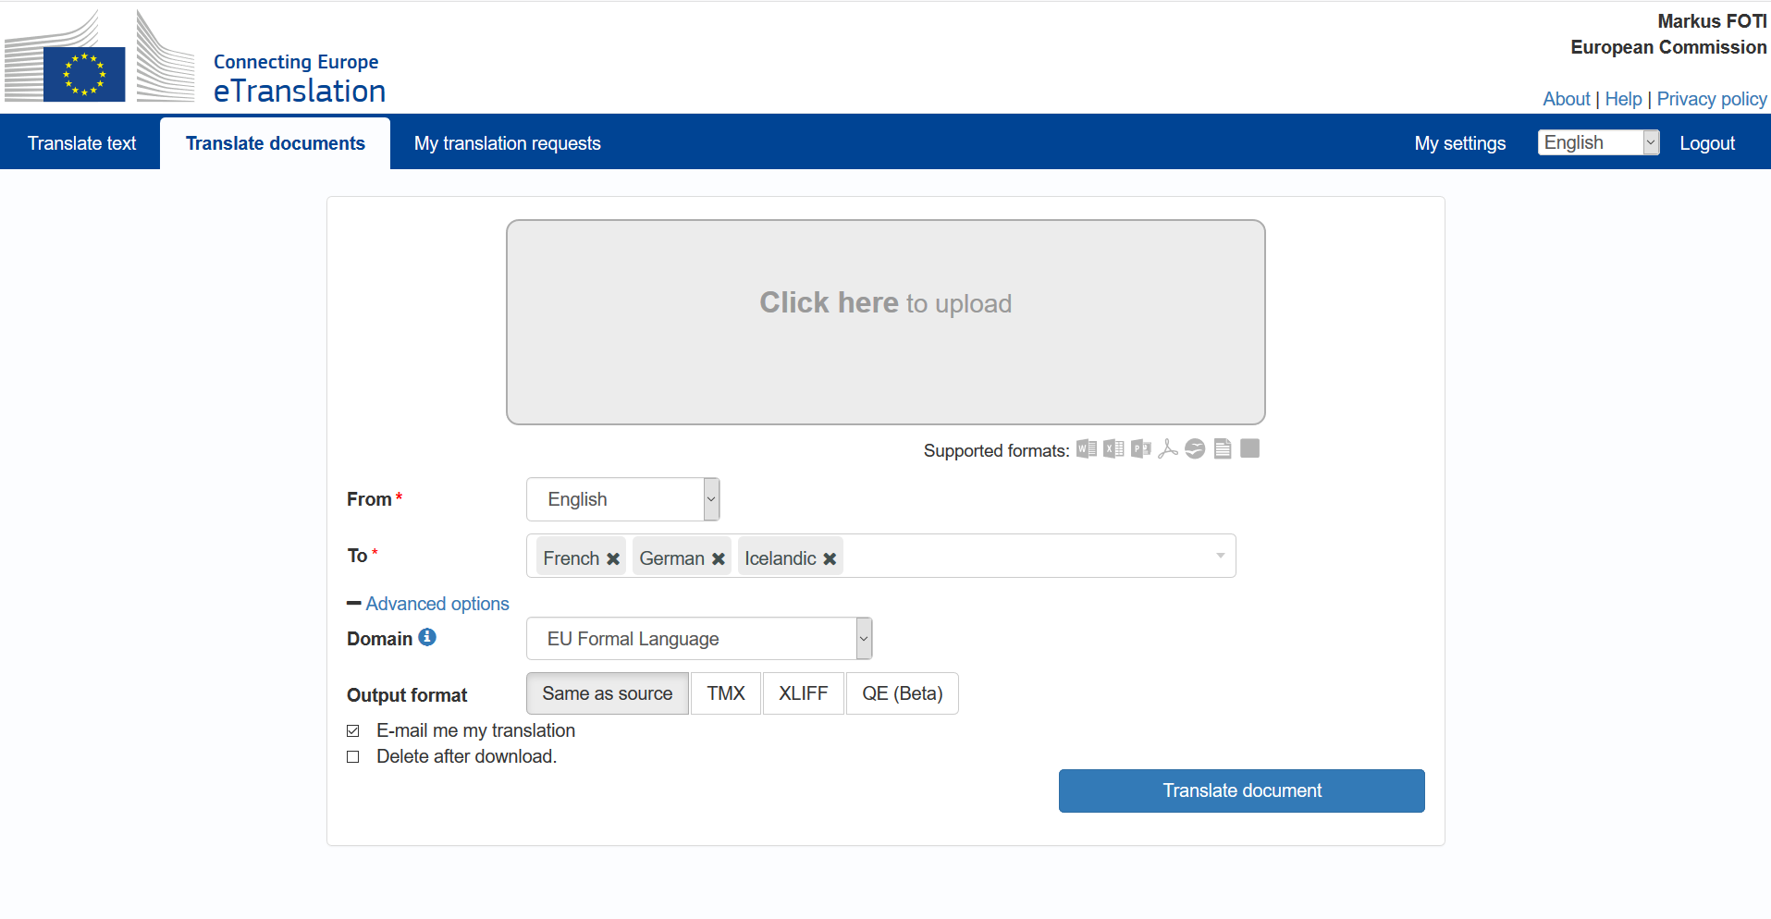
https://webgate.ec.europa.eu/etranslation

Slide 4
Who’s it for?

Slide 5
One system – two audiences
Broader EU
EU Institutions
Translators and staff of the EU Institutions
Digital services of the EU Institutions
CEF Digital Service Infrastructures
Pan-European digital public services
Public administrations in Member States, Iceland and Norway
SMEs
Universities
NGOs
Public administrations in Member States
University Language Faculties

Slide 6

I’m a SME. Is eTranslation for me?
YES!
eTranslation is open to European SMEs since March 2020
Specific conditions and limitations apply.
European NGOs too!
Notes:
Add the specific terms / limitations for SMEs?

Slide 7
What Can I do with eTranslation?

Slide 8
One system – two Use Scenarios
Web interface for humans
Machine-to-machine service (API)
Integrate in workflows, websites, digital services, etc.
Automatically translate your texts for review by translators
Rough translations to get the gist

Slide 9
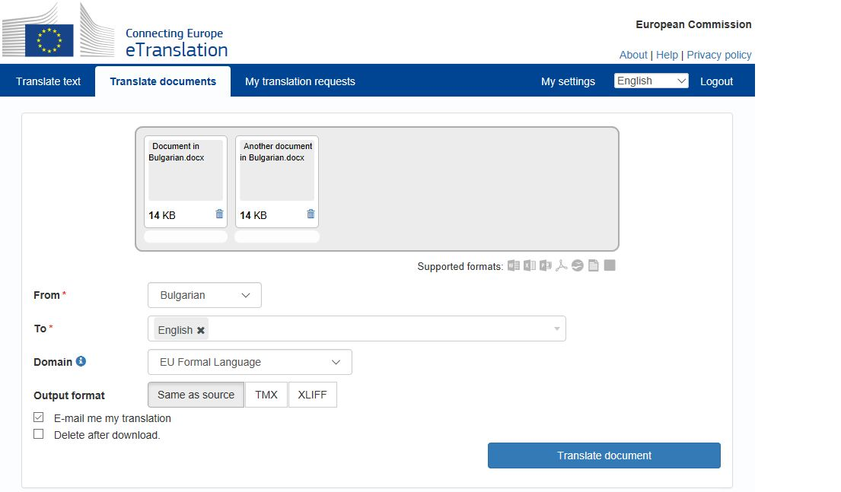







Supported formats:
.txt
+

Slide 10
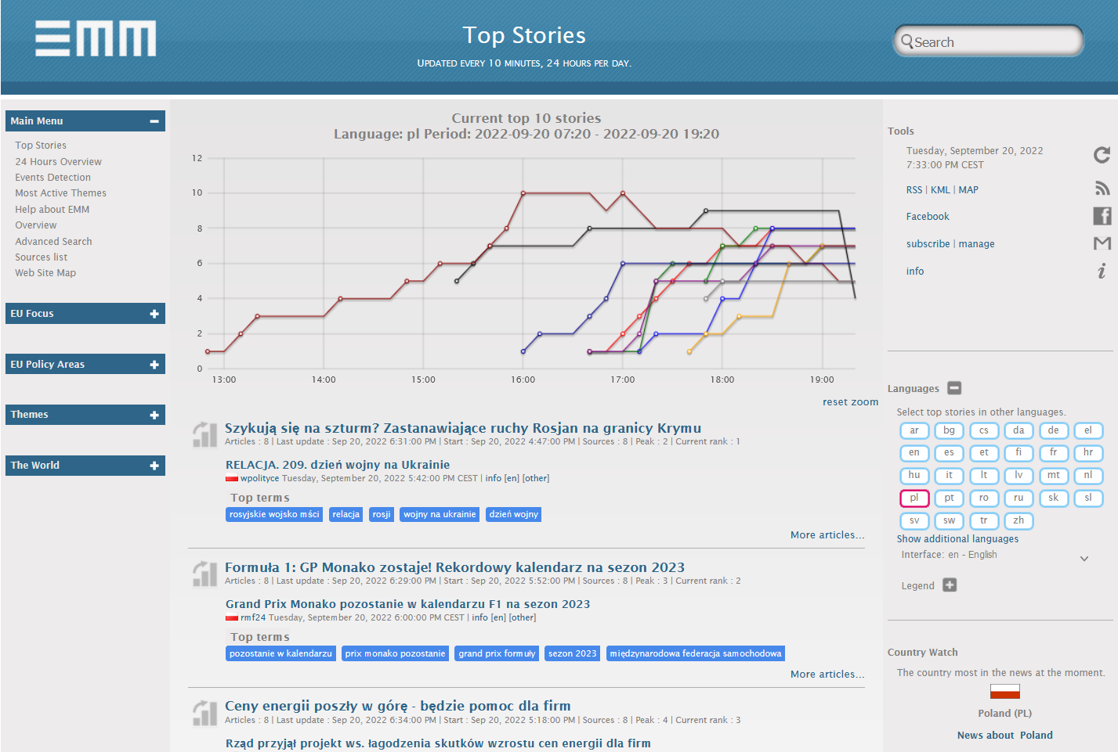
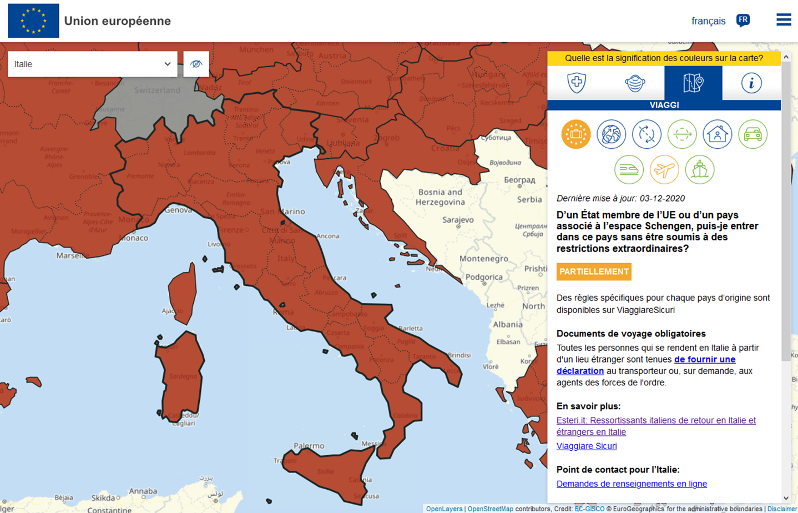
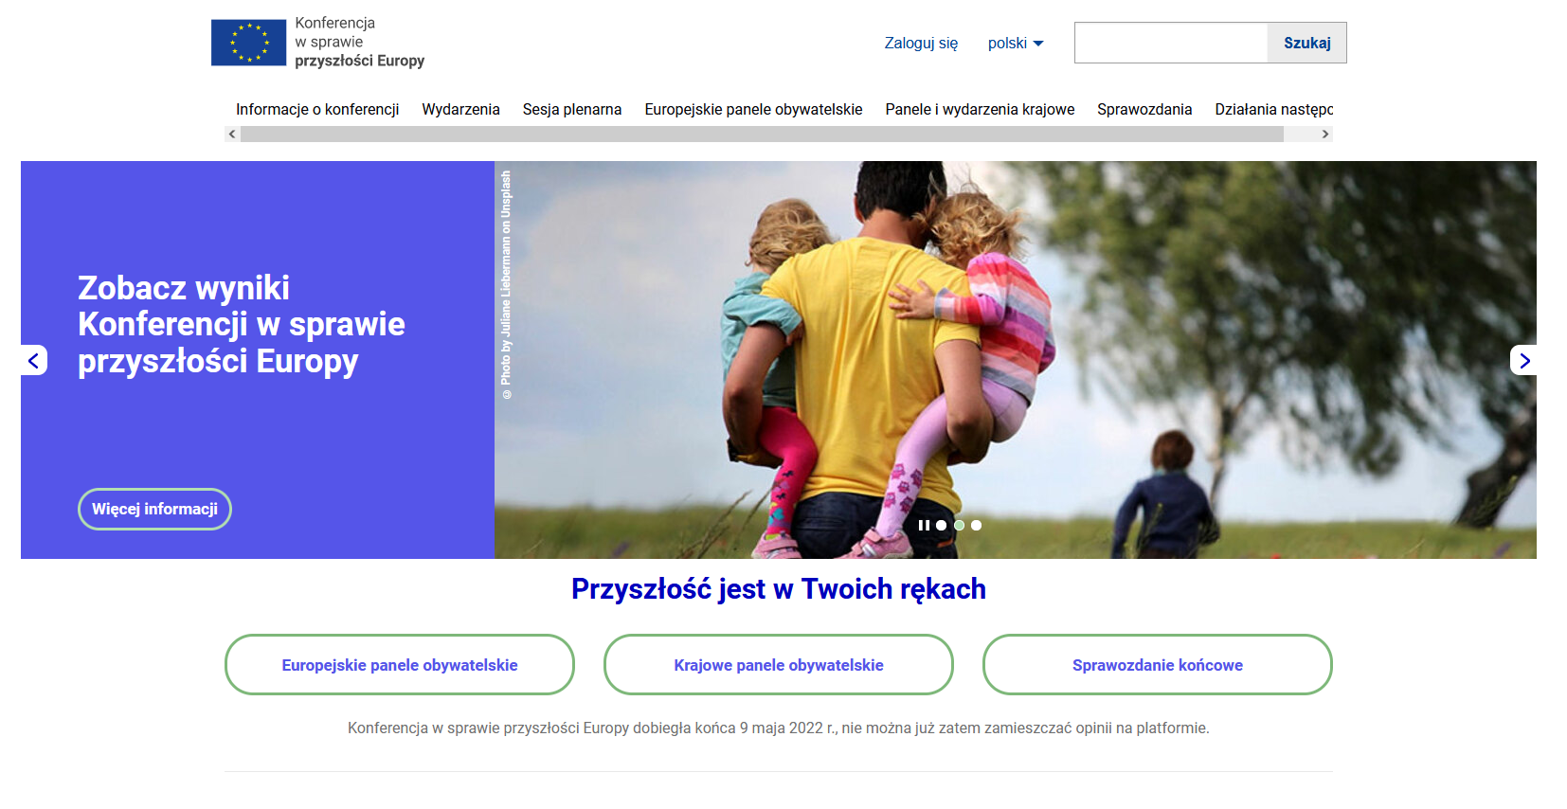
Not only for people
Almost 100 systems connected

Slide 11





Integrate eTranslation directly into your digital services
Translations to and from any of the 24 EU official languages, Icelandic and Norwegian
Request machine translations for text snippets or documents on demand
Translate documents in various formats (doc, pdf, odt, xlsx, html etc.)

Slide 12
What about the translation quality?

Slide 13




What works best
Texts related to EU policies

Slide 14
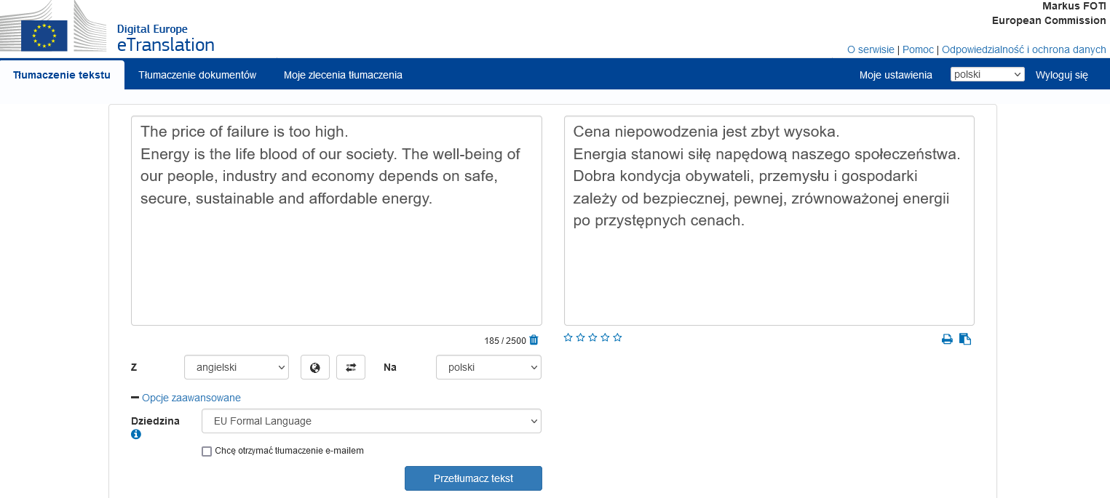
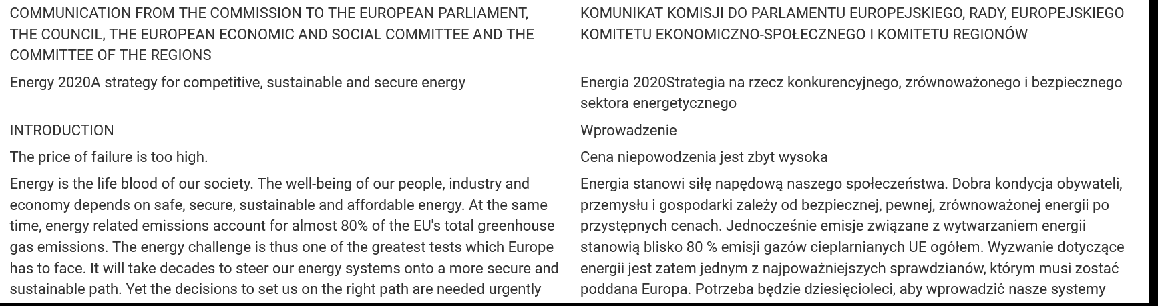

Slide 15
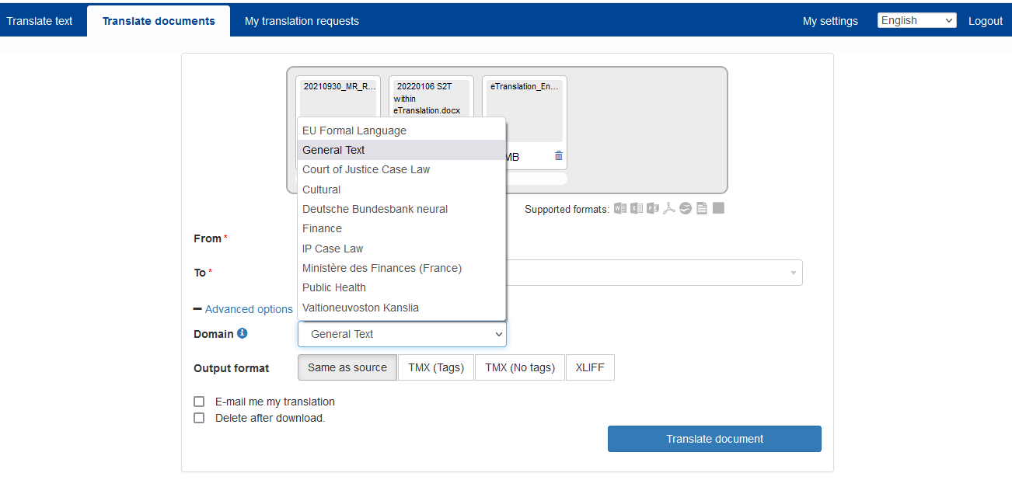
Domain-specific translation

Slide 16
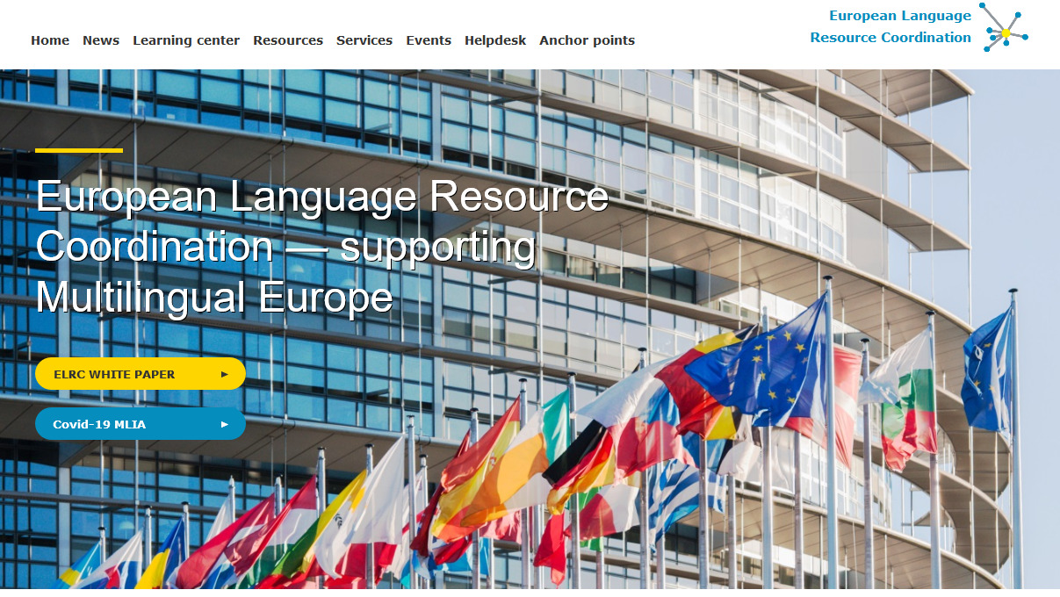


eTranslation – sources of data

Slide 17

eTranslation now available for
Ukrainian!

Slide 18
Data cleaning - Paracrawl
Calculate a alignment score for every segment
  by converting every sentence into a vector
Eliminate all segments below a certain threshold
  the threshold is arbitrary and chosen by humans
Special emphasis on alignment errors and sentence length
  different language versions of websites are not always identical
  sometimes a translation of a website is not complete
  sometimes a translation has been adapted for an audience and contains slightly different information

Slide 19
New Challenges
Antônio Pereira de Sousa Caldas (November 24, 1762 - March 2, 1814) was a Colonial Brazilian poet, priest and orator, patron of the 34th chair of the Brazilian Academy of Letters.
António Pereira Sousa Caldas (Rio de janeiro, - Rio de janeiro,) foi um sacerdote católico, poeta e orador sacro brasileiro, além de autor de diversas obras líricas de caráter filosófico.
Estácio de Albuquerque Coimbra (October 22, 1872 - November 9, 1937) was a Brazilian lawyer and politician.
Estácio de Albuquerque Coimbra (Barreiros, - Rio de janeiro,) foi um advogado e político brasileiro.

Slide 20
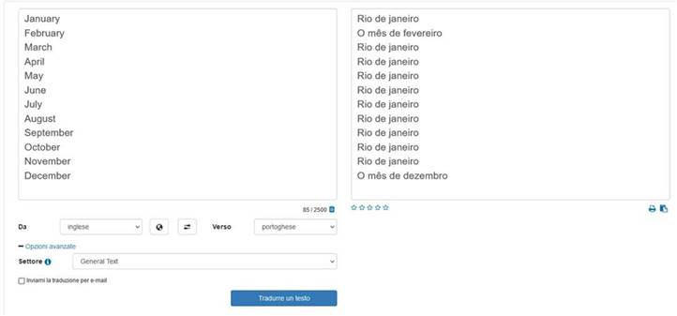
New Challenges

Slide 21
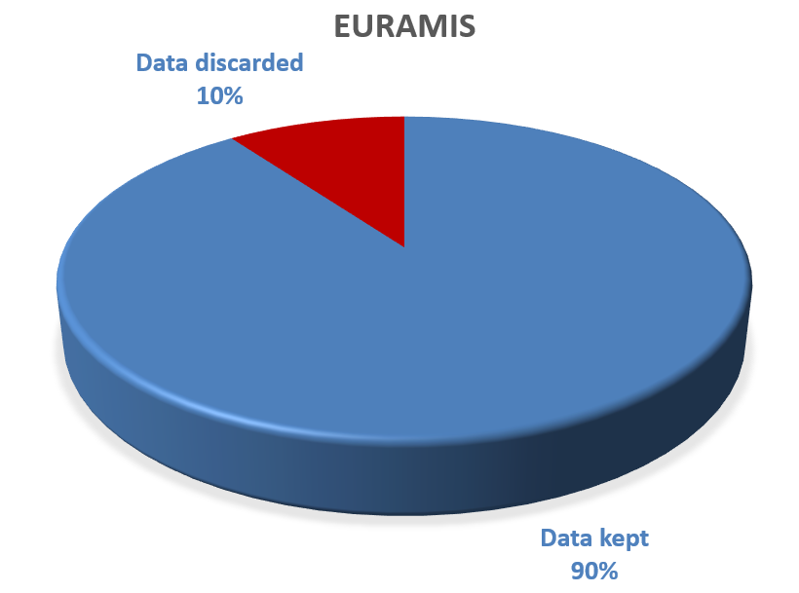
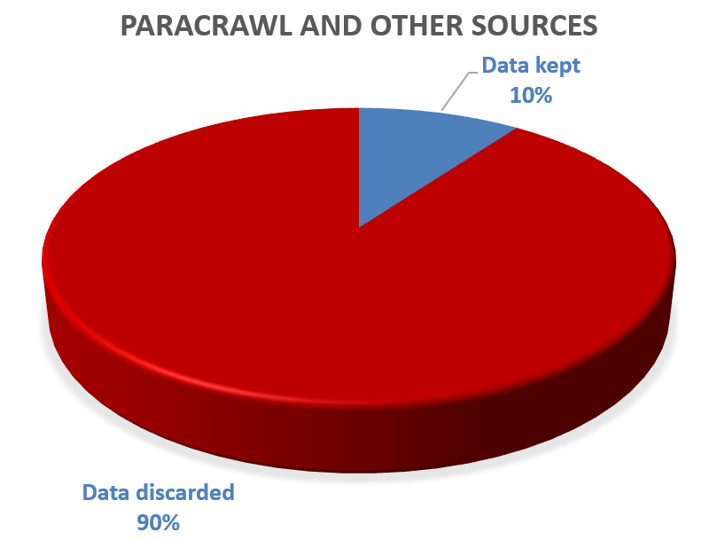
Euramis and external sources

Slide 22
What works less well
Non-standard, new or creative text
Single words or expressions, and anything that depends on context

Slide 23
An example: eTranslation on non-standard text
EN
FR
The chair was broken for the duration of the meeting.
Le président est cassé pour la durée de la réunion.
Notes:
Only 1 out of the first 30 hits in Euramis for chair referred to object with four legs that you sit on

Slide 24
A second example: eTranslation (EU domain engine)
EN
FR
Come gather round people wherever you roam, and admit that the waters around you have grown.
The Times They Are A-Changin’, Bob Dylan
Venez rassembler des personnes où que vous utilisez l’itinérance aux tarifs nationaux, et admettre que les eaux autour de vous ont grandi.

Slide 25
A second example: eTranslation (General text domain engine)
EN
FR
Come gather round people wherever you roam, and admit that the waters around you have grown.
The Times They Are A-Changin’, Bob Dylan
Venez rassembler les gens partout où vous errez, et admettez que les eaux autour de vous ont grandi.

Slide 26
Broad domain coverage (e.g. scientific texts; social media)
Growing language coverage (non-EU languages of social & economic importance, regional languages)
More language tools
  speech-to-text
  anonymization
  named-entity recognition
  basic CAT tool
Notes:
Some more good news saved for the end

Slide 27
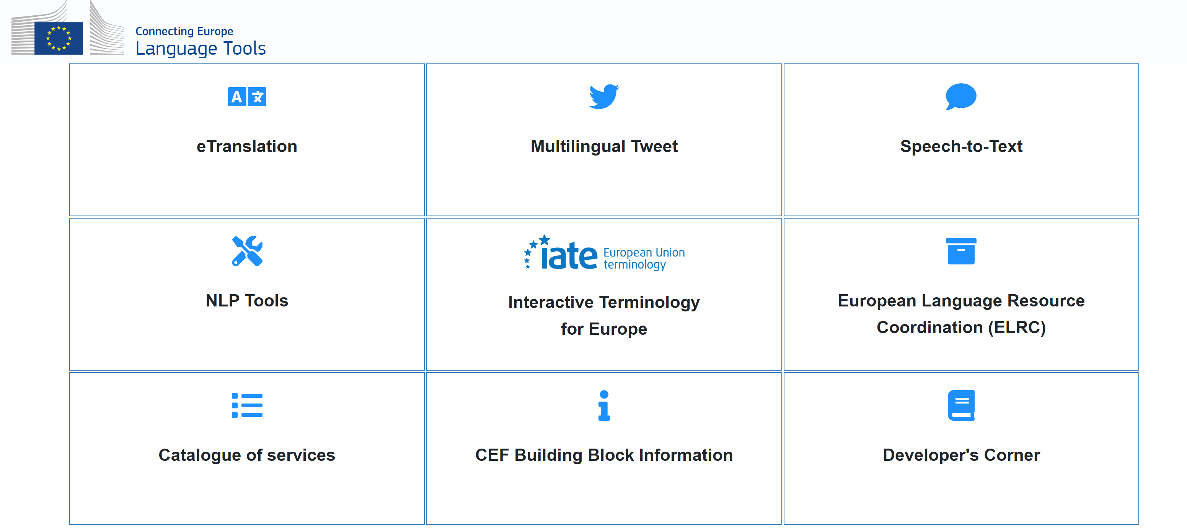
https://language-tools.ec.europa.eu/

Slide 28
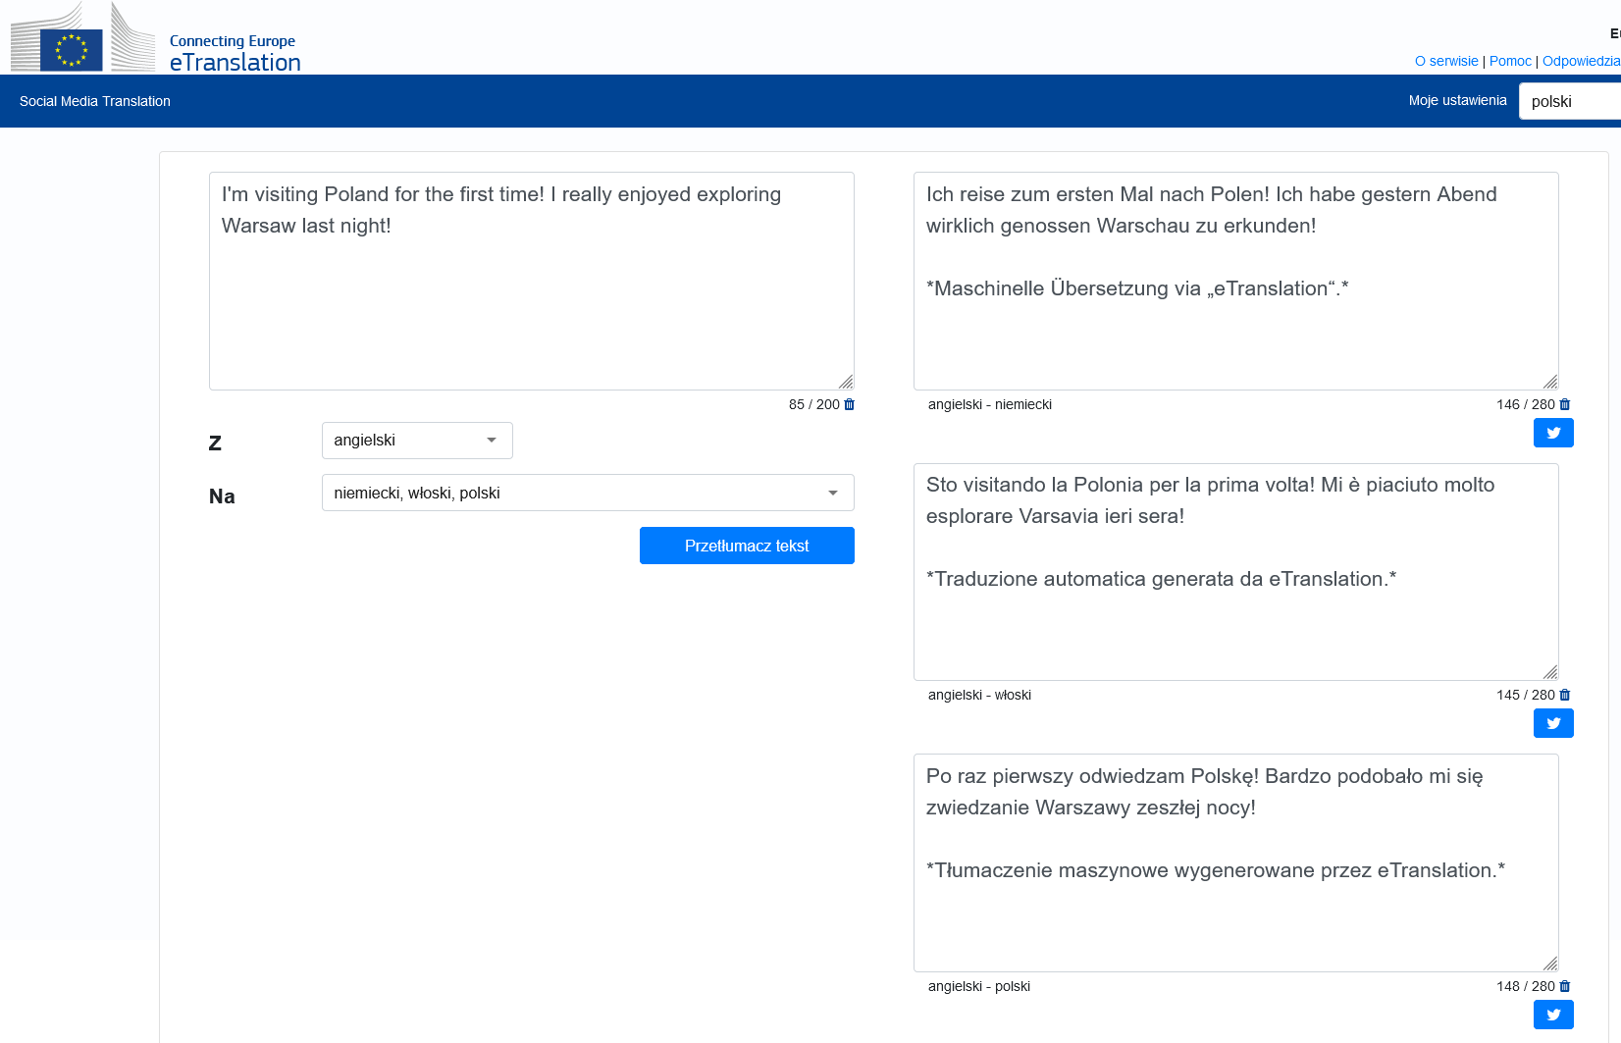

Multilingual Tweet

Slide 29
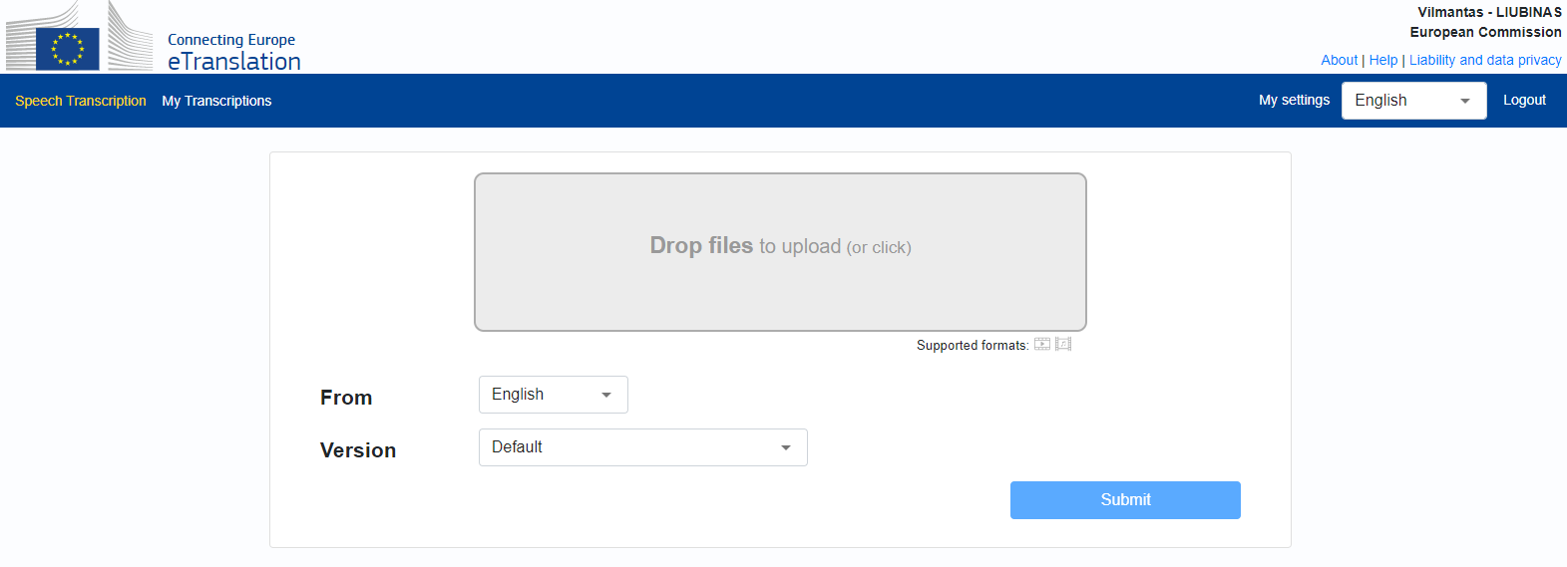


Sound: MP3, WAV,…
Video: MP4, AVI,…

Slide 30
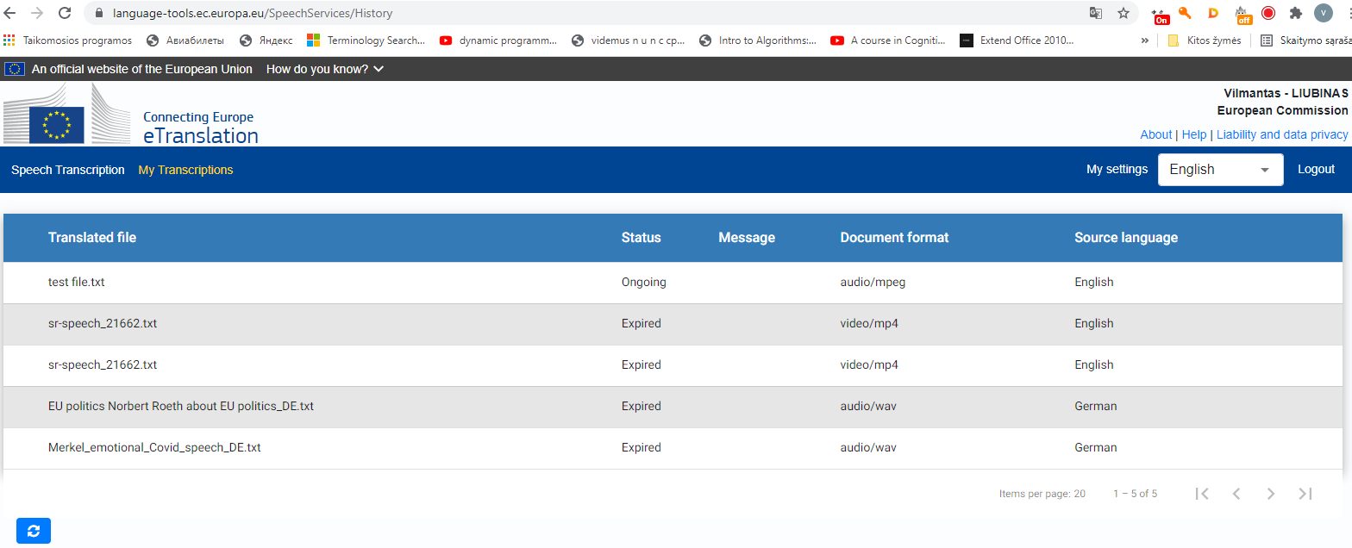
Speech-to-text service

Slide 31
Speech-to-text service
BBC ORIGINAL ARTICLE:
CEF eTranslation platform TRANSCRIPTION:
A teenage girl who donated her hair to a cancer charity found out a year later she has cancer herself. Kiya, 15, sat a GCSE exam on the same day she was diagnosed with stage four Hodgkin's lymphoma after discovering a lump in her neck. Twelve months after donating her hair to the Little Princess Trust, a charity that provides wigs to children with cancer, Kiya, from New Lubbesthorpe in Leicestershire, received her own wig from the charity following chemotherapy treatment. She's now raising money for them and other cancer charities and has had some famous supporters. Scotland captain and Liverpool left-back Andy Robertson told Kiya in a message: "It's so important for you to keep strong and keep fighting. You'll never walk alone.
A teenage girl who donated her hair to a cancer charity found out. A year later she has cancer herself. Kia, 15 years old girl, said at GCSE exam on the same day she was diagnosed with stage four Hodgkin's lymphoma after discovering a lump in her neck. 12 months after donating her hair to the Little Princess Trust, a charity that provides wigs to children with cancer. Kia from new Lubbesthorpe in life. Chester Shire received her own wig from the charity following chemotherapy treatment. She's now raising money for them and other cancer charities and has had some famous supporters, Scotland captain and Liverpool left back. Andy Robertson told Kia in a message. It's so important for you to keep strong and keep fighting. You'll never walk alone.

Slide 32
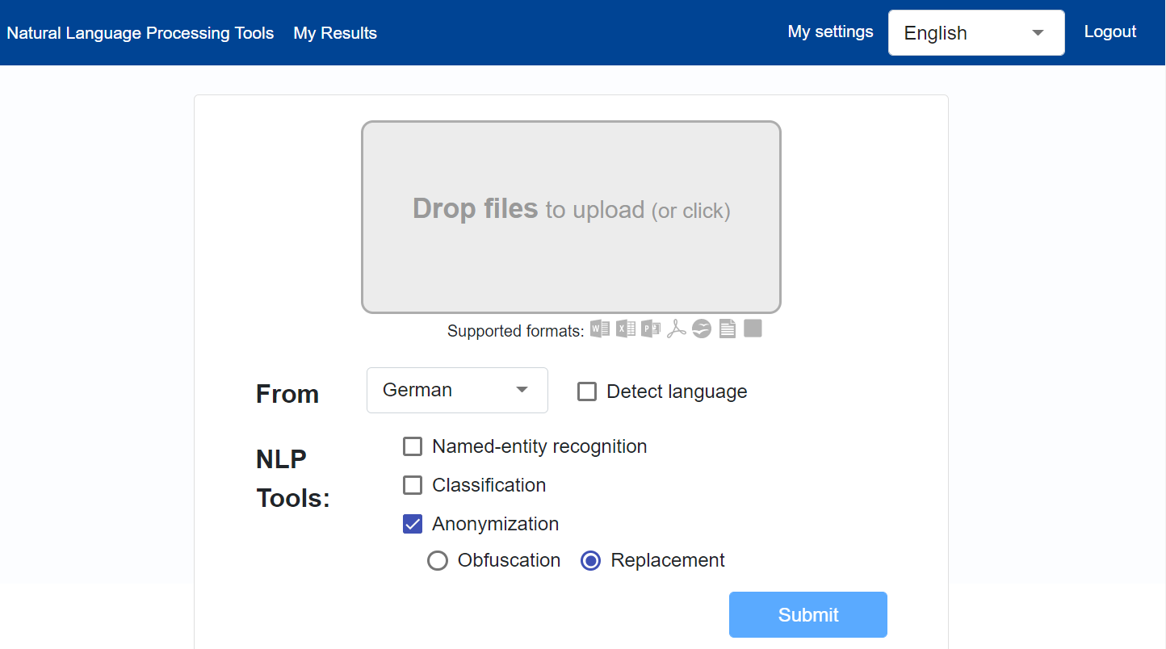
Interface
Anonymisation by Replacement
Anonymisation by Obfuscation (****)
Notes:
Choice of language/detect language has no effect.
Note no choice of model (service provided with multi-lingual administrative model).

Slide 33
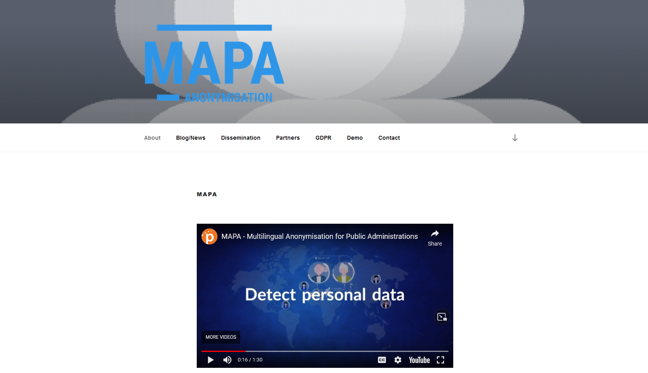
A CEF-funded tool
https://mapa-project.eu/

Slide 34
Entities for Anonymisation
      Dates
      Times
      People
      Addresses
      Organisations
      Amounts
      Vehicles
      Emails
      URLs
Notes:
Emails and URLS - obfuscation and random character replacement. Classic replacement not appropriate in this case.
Can’t pick and choose which entities to anonymise, applies to all users.
Further pattern matching potentially possible (different forms of identifiers, number plates, phone numbers…).

Slide 35
Anonymisation methods
  Original text containing personal data
  Obfuscation
  Replacement
Notes:
Bold red added here for clarity.
Replacement often produces surprising results. When replacing a town and a country as in the example above, there is no guarantee that the replacement town will actually be in the replacement country.
Replacement is usually consistent however. The same replacement should be used for the same entity throughout the text.

Slide 36

Document Categorization (Eurovoc)
Zoo (0.12998)
Cooperation policy (0.11468)
Environmental protection (0.11241)
Community programme (0.11026)
INPUT:
Source document
(22 EU languages)
Protection of animal life (0.09938)

Slide 37
How to register?

Slide 38
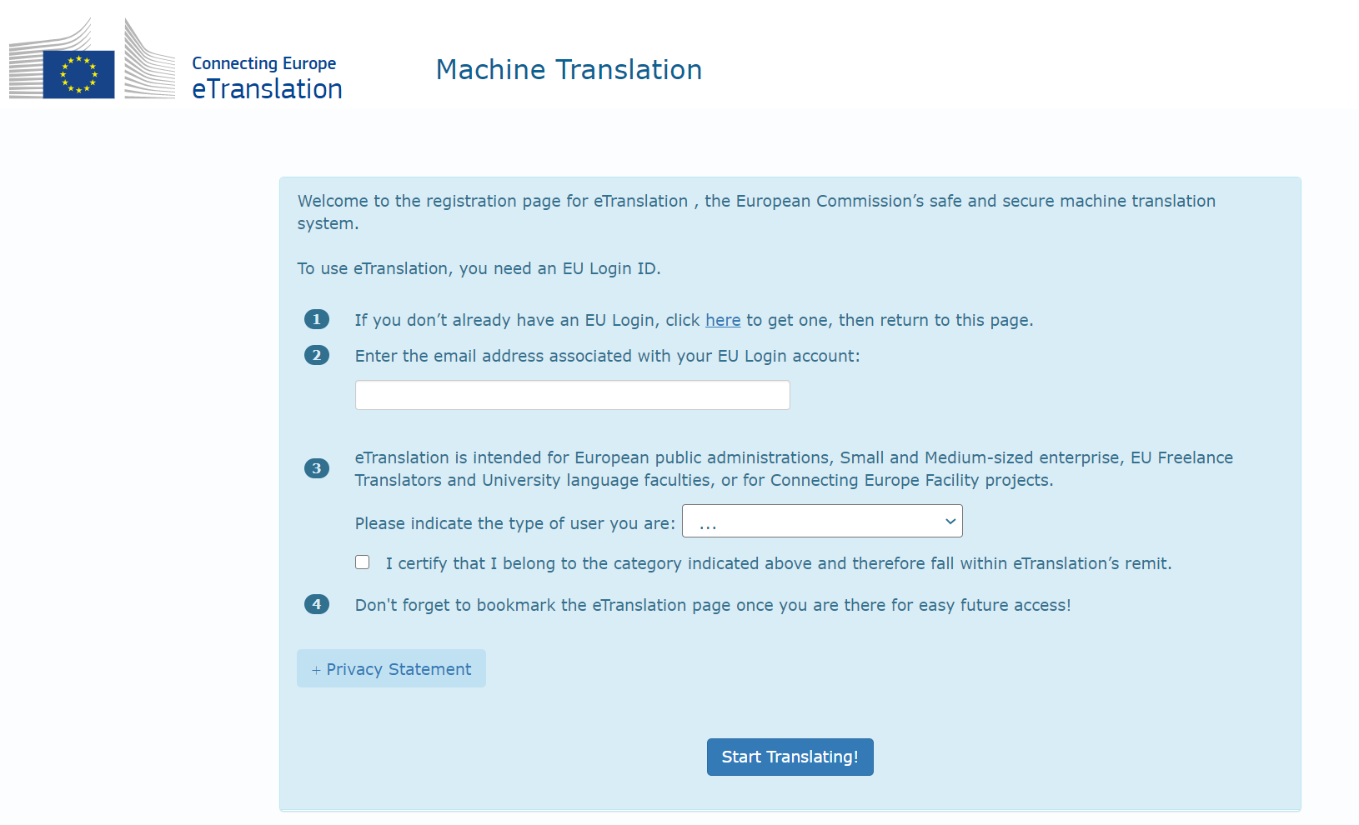
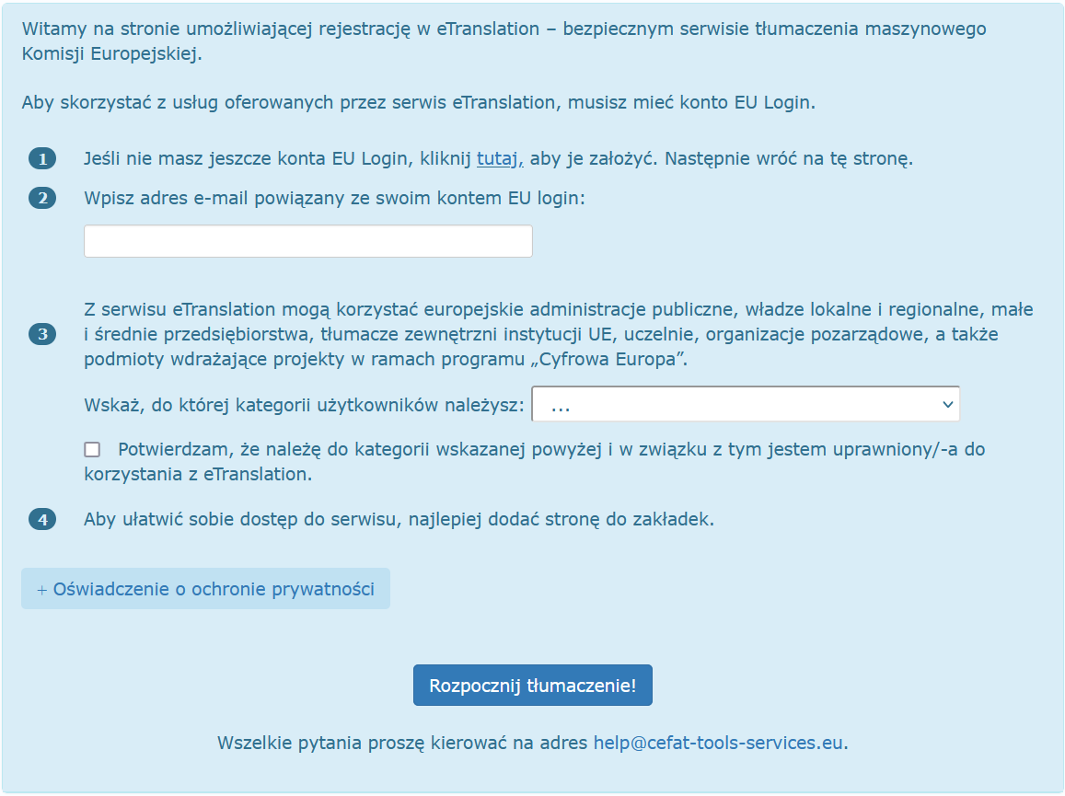

Slide 39
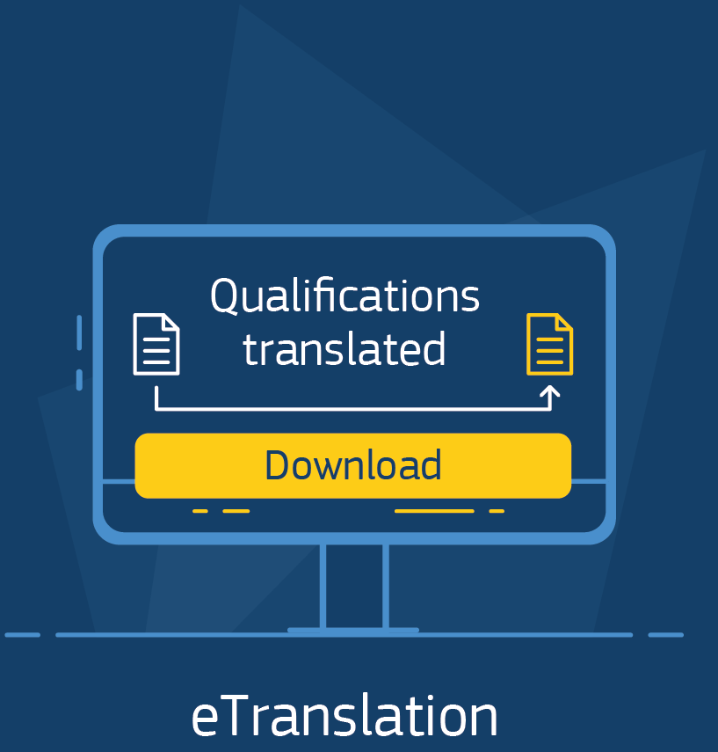
Eligible individual users
  Public Administrations
  Universities
  CEF-funded projects
  SMEs (upon validation)
  NGOs

Slide 40
Give it a try!
https://webgate.ec.europa.eu/etranslation

Slide 41
Dziękuję!
DGT-ETRANSLATION-ADVISORY@ec.europa.eu

